Slide 1
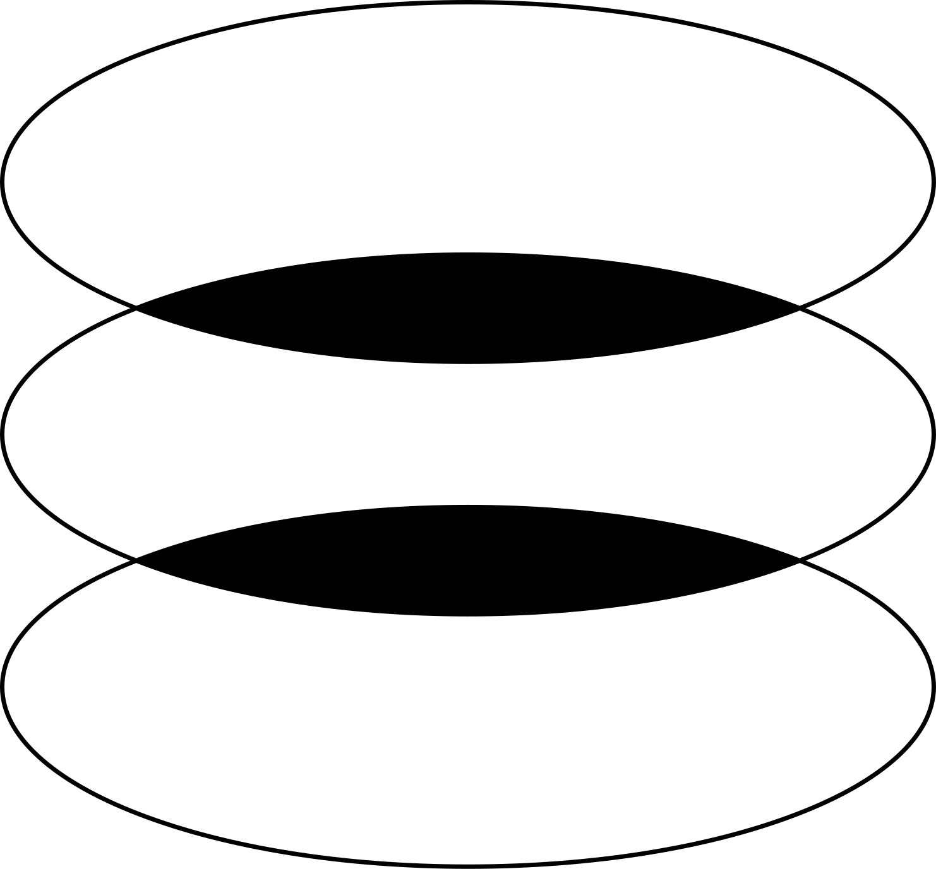
BMI Calculator
  From Command-Line to GUI-Based Applications
Presented By:
Varshini A

Slide 2

Overview
  Introduction
  Easy Version Implementation
  Easy Version Overview
  Methodology
  Easy Version Technologies Used
  Results
  Conclusion

Slide 3

Introduction
Brief Overview of the BMI Calculator Project The BMI (Body Mass Index) calculator project aims to provide a tool for users to determine their BMI based on their height and weight. The project is divided into two versions: a simple console-based implementation and a more advanced graphical user interface (GUI) version.
Comparison of Easy and Advanced Versions The easy version of the BMI calculator is a basic console application that takes user input for height and weight, calculates the BMI, and categorizes it. The advanced version includes a GUI for a more user-friendly experience, along with additional features like unit conversion and error handling.

Slide 4

Easy Version
Objective: Calculate BMI Using User Input The easy version's goal is to perform BMI calculations based on user input for height and weight, and provide a categorization based on the calculated BMI.
Features
  User input for height and weight.
  BMI calculation.
  Categorization of BMI.
Technologies Used
  Python

Slide 5

Implementation
  User Input Handling: The application prompts the user to input their height in meters and weight in kilograms.
  BMI Formula Implementation: The BMI is calculated using the formula: BMI = kg/m^2
  Categorization: The BMI value is categorized into underweight, normal weight, overweight, or obesity.

Slide 6
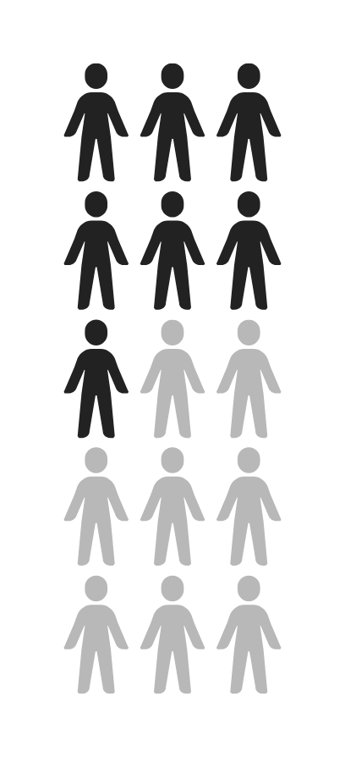
Advanced Version
Objective: Provide a Graphical Interface for BMI Calculation The advanced version aims to create a user-friendly application with a graphical interface for calculating BMI, including unit conversions and enhanced error handling.
Features:
  GUI for user input.
  BMI calculation.
  Categorization.
  Data visualization (future improvement).
Technologies Used:
  Python
  Library: tkinter

Slide 7
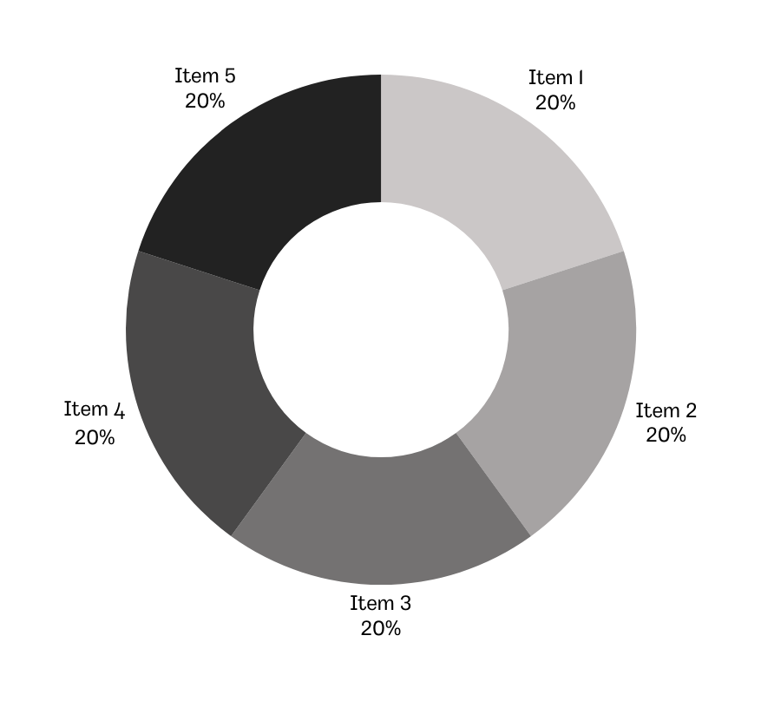
Implementation
  GUI Design with tkinter: The application uses tkinter to create a graphical interface for user interaction.
  BMI Calculation and Categorization: Similar to the easy version, but with added functionality for unit conversion and better user interaction.
  Error Handling: The application includes error messages for invalid input and unexpected errors.

Slide 8
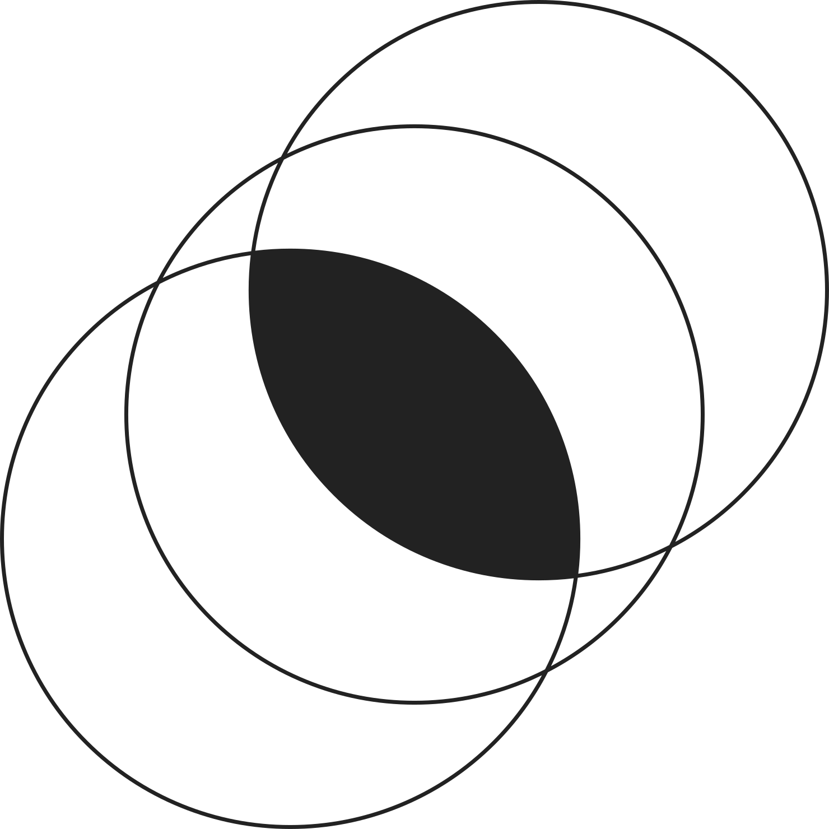


  Summary of Both Versions
The easy version of the BMI calculator is a straightforward console application that handles basic input and output for BMI calculation. The advanced version significantly enhances user experience by providing a graphical interface, unit conversion, and better error handling.

Slide 9
Potential Future Improvements
  Data Visualization: Add graphical representations of BMI data for better understanding.
  Health Recommendations: Provide personalized health and fitness recommendations based on BMI.
  Historical Data Tracking: Allow users to track their BMI over time.
  Integration with Wearable Devices: Connect with fitness trackers to automatically update height and weight data.
  Multi-Language Support: Offer the application in multiple languages to reach a broader audience.

